Slide 1
JMP/Excel Workshop
Consulting Subcommittee
Qiaoxuan (Josh) Wang Joyce Lu

Slide 2
Background
Applications & Workflow
Engagement Activity
Q&A

Slide 3
[01] Background

Slide 4

Excel for Data Analysis
Can be used to examine data and perform simple and basic data analysis
Convenient for data entry
Here are some useful methods for data analysis:
Charts
Ranges
Conditional formatting
Sorting and filtering
Data validation
Formula auditing
Pivot tables
Source: https://www.analyticsvidhya.com/blog/2021/11/a-comprehensive-guide-on-microsoft-excel-for-data-analysis/

Slide 5
What is JMP?
A statistical software that can perform data preparation, analysis, and graphing
Simple to use because there is no code required
What can you do with JMP?
Data cleaning, data summary, data visualization, Statistical analysis, machine learning…
Link to the tutorial videos provided on the JMP website: https://www.jmp.com/en_dk/academic/course-materials/analytics.html#m-stepbystep
Source:

Slide 6
[02]
Applications / Workflow

Slide 7
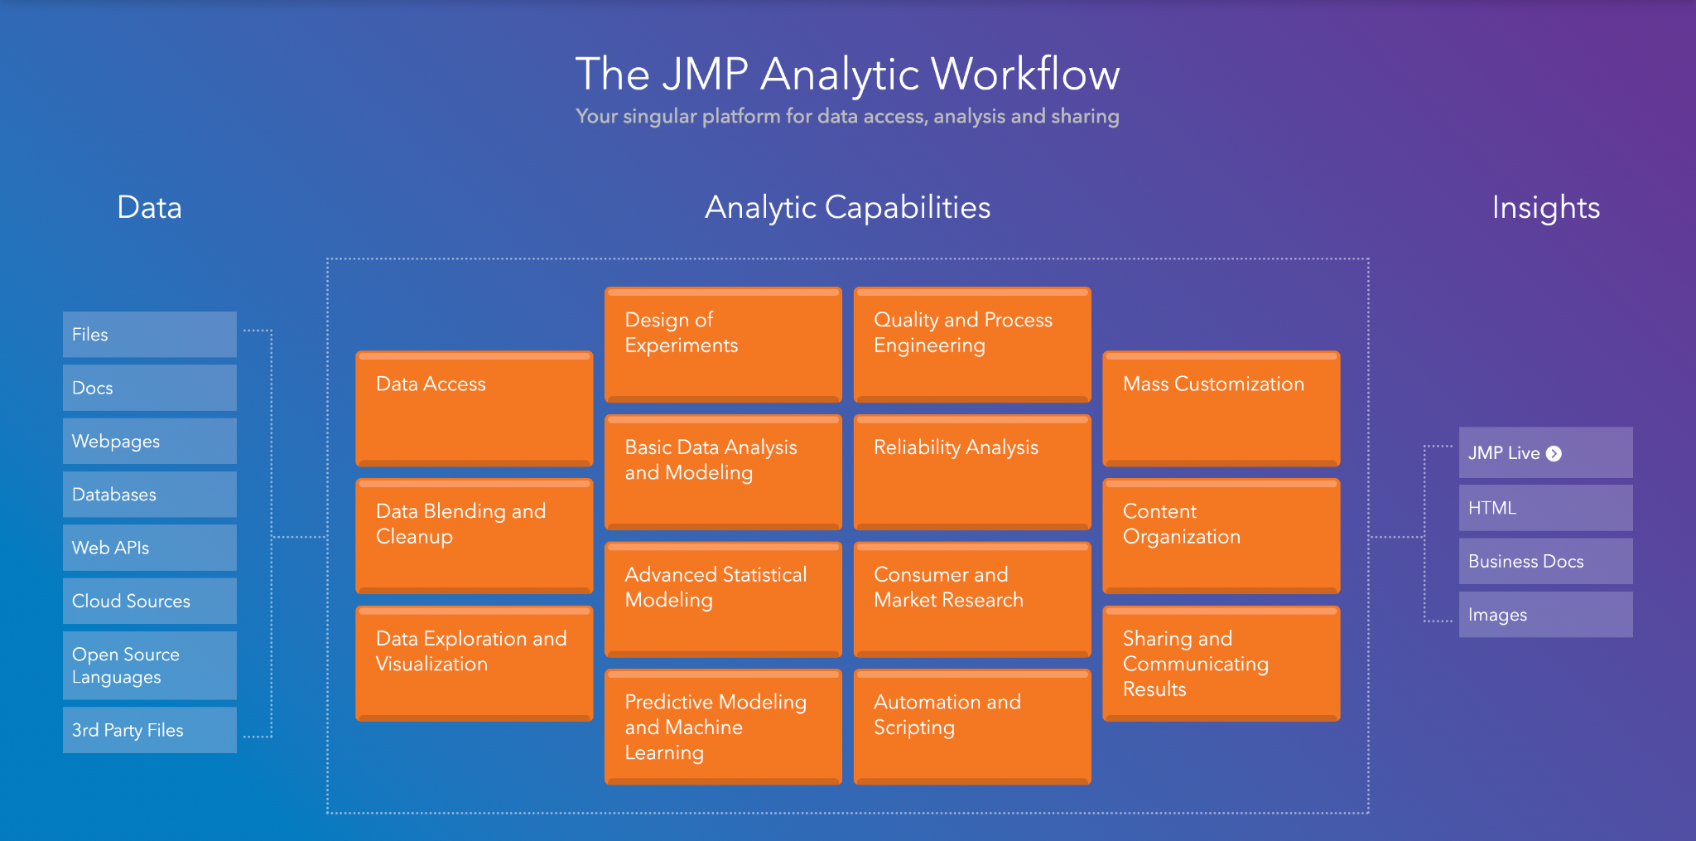
JMP Analytic Workflow
Source: https://www.jmp.com/en_us/software/analytic-workflow.html

Slide 8
Data Access
Easy to access data from a variety of sources
i.e. Excel, files, databases, APIs, R, python, etc.
When data is imported into JMP, they are already formatted and ready to visualize and analyze
Source: https://www.jmp.com/en_us/software/capabilities/data-access.html

Slide 9
Data Cleanup
We can perform various data cleaning tasks using JMP, such as:
Shaping tables
Merging data
Anomaly detection
Dealing with missing data
Source: https://www.jmp.com/en_us/software/capabilities/data-blending-and-cleanup.html

Slide 10
Data Exploration & Visualization
Graphing
Histograms, box plot, tree map, and many more
Data Summary
Finding mean, median, frequency, variance, etc.
Filtering (subgrouping)
Dashboards
Explore texts
Word cloud, etc.
Source: https://www.jmp.com/en_us/software/capabilities/data-exploration-and-visualization.html

Slide 11
Analysis
What can we do with JMP?
One way & two-way ANOVA (analysis of variance)
Correlation
simple/multiple linear/logistic regression
Bootstrapping
Clustering
classification trees
regression trees
k nearest neighbors
…and many more
Source: https://www.jmp.com/en_us/software/capabilities/data-exploration-and-visualization.html

Slide 12
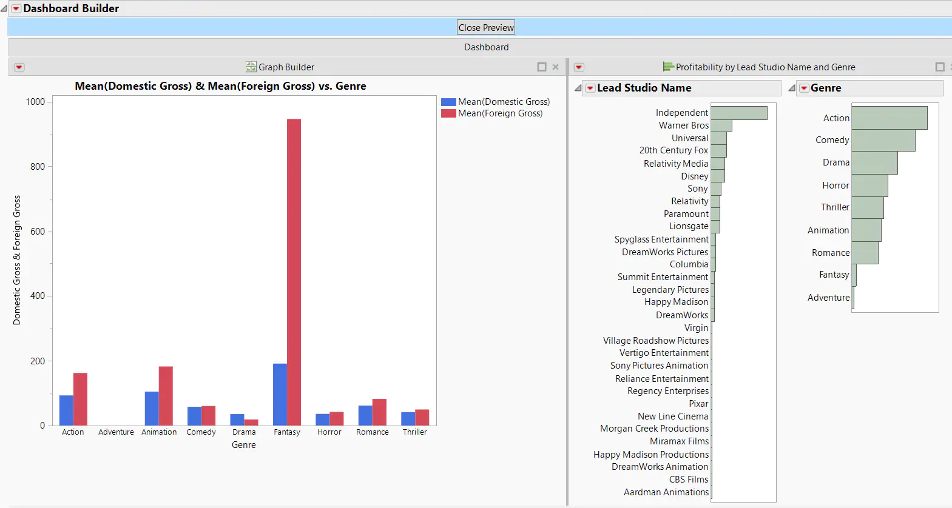
Sharing and Communicating pt.1
JMP Live
A cloud location to store and share your reports and data with other JMP users
Interactive HTML
Sharing reports and data with non-JMP users
Dashboard
Source: https://www.jmp.com/en_us/software/capabilities/sharing-and-communicating-results.html

Slide 13
Sharing and Communicating pt.2
JMP Journals
1. Static presentation
Embeds the output of one or more JMP reports
Looks similar to when we save output to a PDF
No data table; points cannot be selected or changed
2. Dynamic presentation
Looks like an outline with texts and buttons that reveal / hide certain reports and data tables of your choice
“Dynamic”: those reports and tables can be changed or updated
Workflow builder
Documents actions throughout the preparation and analysis workflows
Source: https://www.jmp.com/en_us/software/capabilities/sharing-and-communicating-results.html

Slide 14
Summary
Similarities
Both are powerful tools in performing basic data analysis
Both are useful data visualization tools (can be used to plot graphs and charts)
Differences
Structure
JMP - data tables
A cell is defined based on its column (one specific variable)
Excel - spreadsheet
You can enter any type of data (mixed character + numeric data) into a cell

Slide 15
[03] Engagement Activity UCSD Enterprise Software Licensing

Slide 16
[04] Q&A

Slide 17







Find us on social media!
@DS3UCSD
@DS3UCSD
Thank you!
Th
@DS3.UCSD
https://tinyurl.com/discordds3
ds3.ucsd.edu
ds3@ucsd.edu
Notes:
GBM is planned for next Thursday (September 24) at 6pm where all the Directors and PVP will be presenting for their respective organizations
How can I get involved? We are recruiting for most subcommittees
Active Community on Discord
People come from various backgrounds (check website for where we have interned, advice/tips), tutoring, HDSI Research Scholarship, professors, research at Qualcomm Institute, etc.
Opportunities, class questions, etc.
Tabling tomorrow! And next Tuesday (Library Walk) and Wednesday (EOTG), additionally we will be speaking at DSC classes either this week or next, etc.

